Slide 1



Slide 2
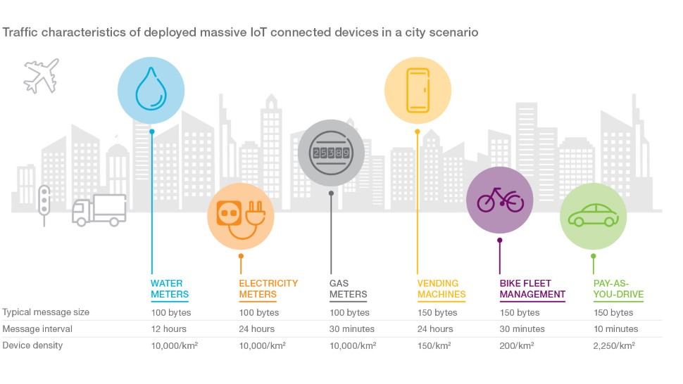
Overview
Herc is a Equipment rental company which has been using sensors for various purposes over the years and now wants to go a step ahead by combining its sensor equipment with a robust telematics platform to address numerous issues with tracking equipment and optimizing operations.

Slide 3
Scope:
Asset tracking through advanced systems that automatically send an alert to employees when HERC equipment assets are entering or leaving a site.
Equipment availability and utilization tracking that enables real-time monitoring of equipment asset status (e.g. idle, underutilized, or mis-used).
Maintenance scheduling that enables automatic scheduling of preventive maintenance based on run-hours of equipment.
Strategy:
Agile model.

Slide 4
Solutions
Telematics information is being tracked and saved in continuous time intervals through Oracle IoT database.
All the services performed on the equipment are monitored and saved so there is an auto service request when the run time of the equipment is about to reach.
Obvious Patterns of equipment failure are saved in the sensors and alerts will be sent to the respective user account before the fault occur.
Web Application and mobile Application with intuitive user interface which helps Herc employees and customers to use the updated services of Herc.
Manageability is offered as a core function.

Slide 5
Non-Functional Requirements:
Performance – Data usage, Response time, Processing time.
Recovery – Backup time.
Scalability – Risk Tolerance, Storage, Accommodate huge growth in data.
Maintainability – Security, Architectural standards, Coding standards
Store reviews – Branch wise, usage of each device and able to give graphs to help in analysis which equipment is highly rented, which equipment is highly trustworthy. which equipment is maximum rented per each branch.

Slide 6


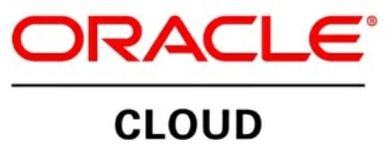

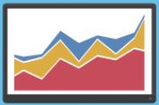
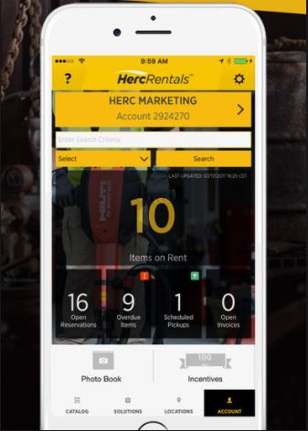
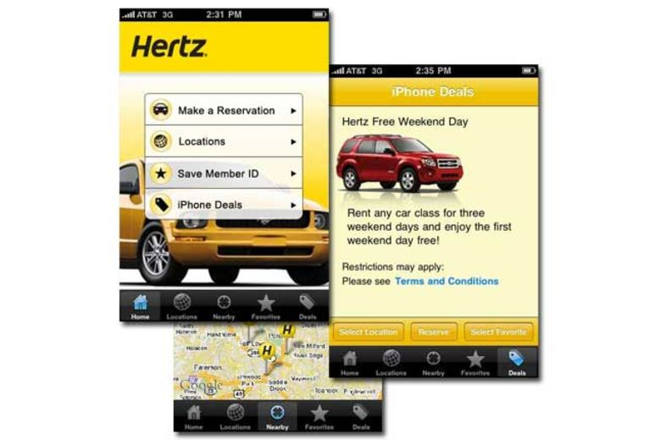
Architecture
Raw data from sensors Processed Data Stored in Hadoop
OracleIoT
Raw Data
Streaming Analytics Alerts and Info Alerts and Info
Data Analysis Employee Portal Customer Portal

Slide 7
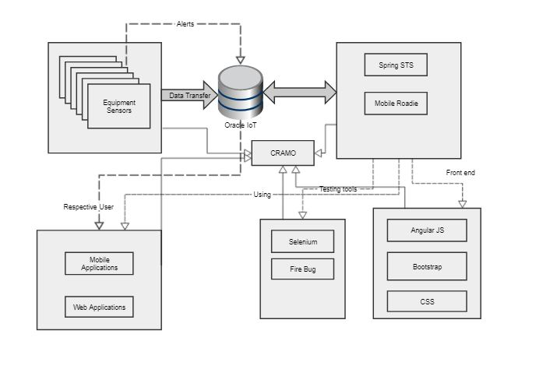
Technical Architecture

Slide 8

Streaming Analytics
Constantly calculate Statistical analytics while moving with the
stream of data.
Processes millions of events per second because data is processed before it lands in the database.
Analyses risks before they occur.
Perform security monitoring of both network and physical assets.
Provides Deeper insights through equipment behavior and helps the sensors which are decentralized in decision making.

Slide 9
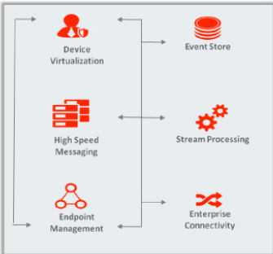
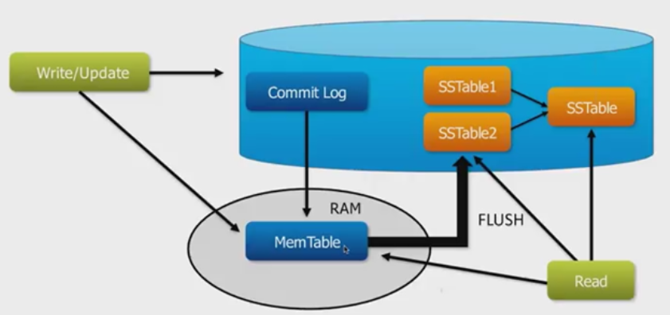
Oracle IoT & Hadoop
Enable the equipment to send data and alert messages to the cloud service and integrate the data into your existing enterprise applications and processes.
Data Preprocessing.
Data aggregation and storage, Parallel processing
Data Replication, Security, Backup and restore

Slide 10
Project Flow
Step 1: The data from sensors is captured using OracleIoT and streamed in to streaming analytics.
Step 2: The data is analyzed and tested for any faulty patterns of equipment and stored in Hadoop.
Step 3: Any threatful patterns are identified and alerts will be sent to the Appropriate roles of users.
Step 4: The Data stored will be retrieved when asked by the customer or herc employee.
Step 5: Hadoop allows to recover deleted and erroneously input data. Rebuilds the environment and data from last saved backup.

Slide 11
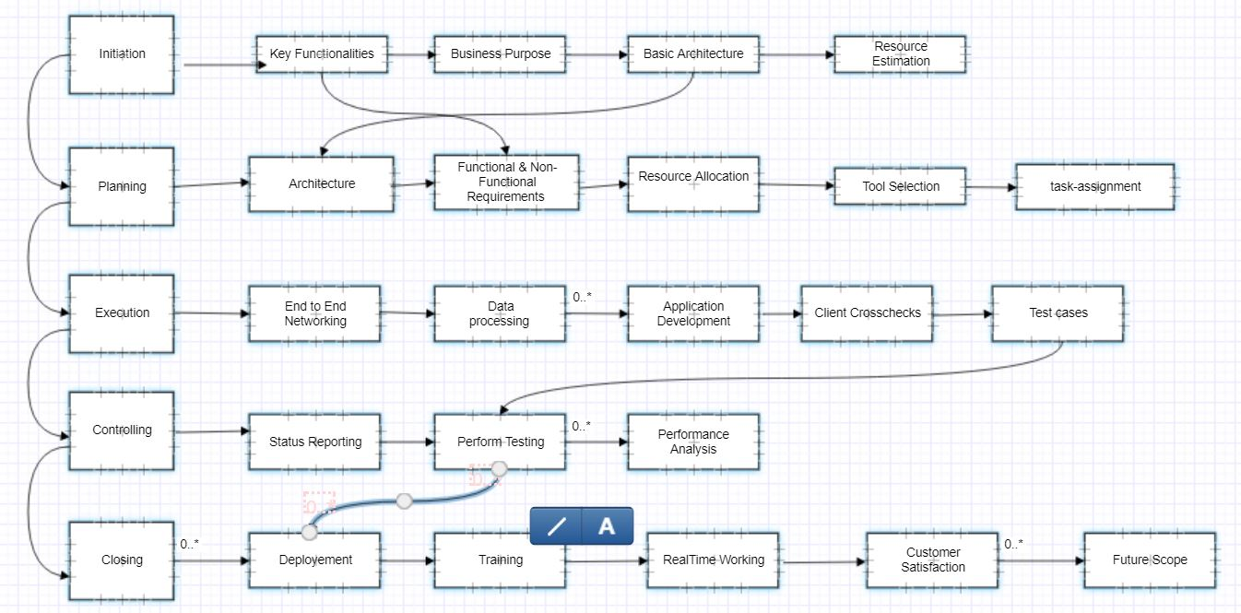
Project Structure

Slide 12
Organizational Structure
Business Architect
Project Manager
Application Architect
Network Architect
Data Analyst
Application Engineer
Systems Architect
Database Engineer

Slide 13
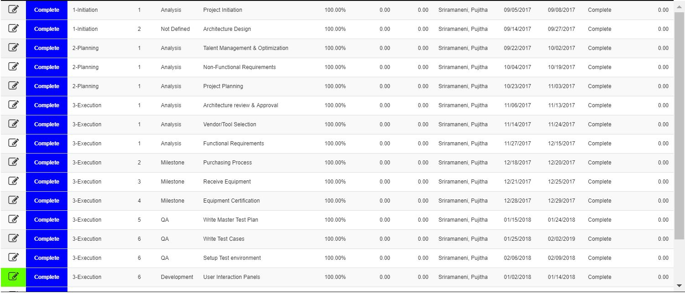
Milestones

Slide 14
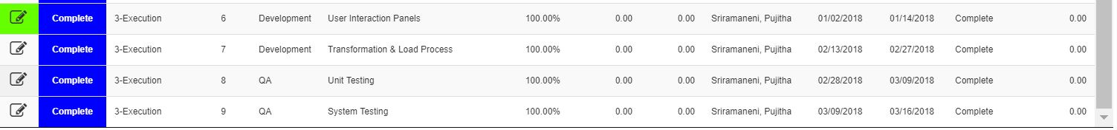
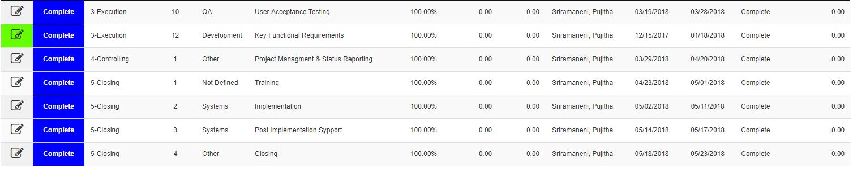

Slide 15
Reflected Changes
Re-architecting the company's ProControl online application, an Internet of Things/telematics and logistics program with an intuitive user interface
If an equipment is not available at a particular location,Suggests the customer to the nearest herc branch where the product is available.
Offer flexible subscription/chargeback models to its customers.
Displays featured equipment and offers based on their previous search patterns.

Slide 16
Sensitive Data & Customer Expectations
Sensitive information like SSN, License number, credit card details must be encrypted.
Customer’s(Herc) main expectation is to retrieve data quickly, accurately. Retrieved data from sensors has to be saved in the database without fail.
The system has to be able to work without halts even when a server is partially failed. (Cassandra takes care)

Slide 17
Strengths: Weakness:
Increases the life of equipment. High use of Internet.
Reduces equipment loss. Complete dependency on Internet.
Quality of Service Quite difficult to reach without smart phone
Ease of Data Analysis Could be expensive
Self Management of Sensors Calibration
Threats: Opportunities:
Data Privacy. Future Scope Increases with growth of IoT
Corrupted data transmission.
Downfall of IoT

Slide 18
Risks
Incompatible Software versions
Network Failures
Functional Failures
Data Corruption

Slide 19
OUTLINE BUSINESS CASE
Using emerging technologies like IoT makes it easy to expand the services provided by the company.
A step ahead of other companies regarding IoT projects.

Slide 20
THANK YOU!

